Slide 1

HOSPITAL MANAGEMENT SYSTEM

Slide 2


Chandibai Himathmal Mansukhani College
Guided By :
Ms. Lata Bhatia
Presented By :
Mr. Sahil Vishwakarma

Slide 3
Hospital Management System is a project which aims in developing a computerized system to maintain all the information of hospital entities.
INTRODUCTION
It has a facility of admin login through which the admin can monitor the
whole system.
Administrator can maintain daily updates in the requests of the patient, donor etc. Administrator is must be an authorized user.
Admin modules are managing patients, manage doctors,
and manage appointments.
users can enquire about the patient registration availability if he/she wants to get the Hospital.
Overall this project of ours is being developed to help the
hospital administration, maintain the hospital
management in the best way possible and also reduce the
human efforts.

Slide 4
The main objective ofthis project is to manage the records of patients, doctors and appointments.
OBJECTIVE
Reduce the paper work and provide the 24*7 accessible website with
user-friendly GUI (Graphical User Interface)
to manage the records.
Collect detailed description of the patient who are interested in blood donation.
Rules, terms and conditions for patient Entry.

Slide 5
There is always a need of a system that will perform online registration of patient in hospital.
NEED OF THE SYSTEM
This system will reduce the manual operation required to
maintain all the records. And also generates the various
reports for analysis.

Slide 6
To manage the hospital administrative work. It helps to register patient online and register in hospital from anywhere.
PURPOSE
This project also helps doctors work such as keep
information of patient and appointment bookings and
helps in giving prescriptions to patients.

Slide 7
The project has a wide scope, as it is not intended to a particular organization. This project is going to develop generic software, which can be applied by any businesses organization. More over it provides facility to its users. Also the software is going to provide a huge amount of summary data.
PROJECT SCOPE

Slide 8
SYSTEM ANALYSIS
There are four basic elements in system analysis as following:
Output: First of all, we must determine what the objectives or goals are, what do we intend to achieve.
Input: Once we know the output, we can easily determine what the input should be. Sometimes, it may happen that the required information may not be readily available in the proper form.
Files: As the word implies files are used to store data.
Process: Here we come to the details of how the input and files are converted into outputs. This involves the programs and the way in which data is processed through the computer.

Slide 9
ADMIN MODULE
Admin
Manage Registration for Patients
Manage Blood Donors information like (update, delete)
Manage Donor Request for Donor
Manage patient Request
Manage Inquiry form for Appropriate Reply
Manage feedback for Appropriate Reply

Slide 10
ADMIN MODULE
2.Doctor
Doctor information view/update
View Doctor information
Manage Patient Request.

Slide 11
PATIENT MODULE
1.Patient
Manage Patient information(profile)
Give the Request for patient for blood

Slide 12
Front End Language
Java Server Pages (JSP)
Servlet
Hibernate
Extensible Markup Language (XML)

Slide 13
Application Server Tomcat
RDBMS Oracle 10g
RAD Tools Notepad
HTML Editor Macromedia Dreamweaver MX
Scripting Language Java Script
Database mysql
SOFTWARE USED NETBEANS

Slide 14
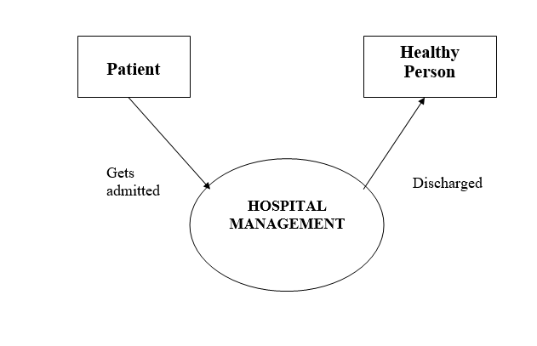
DATA FLOW DIAGRAM
Context Level DFD

Slide 15
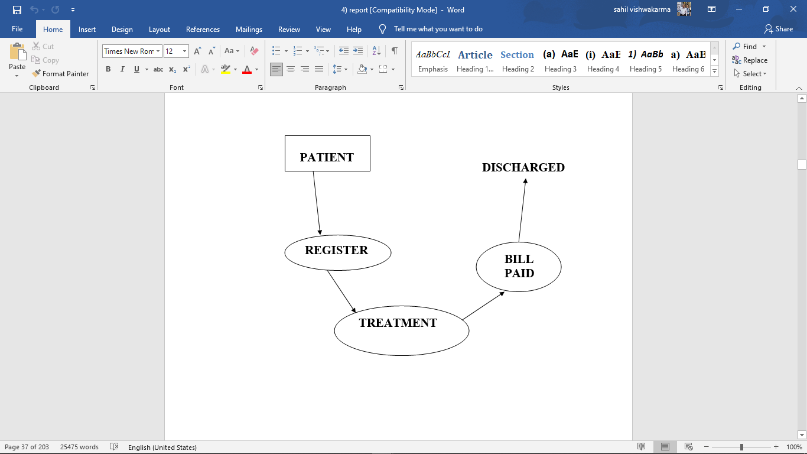
DATA FLOW DIAGRAM
Second Level DFD

Slide 16
ER DIAGRAM

Slide 17
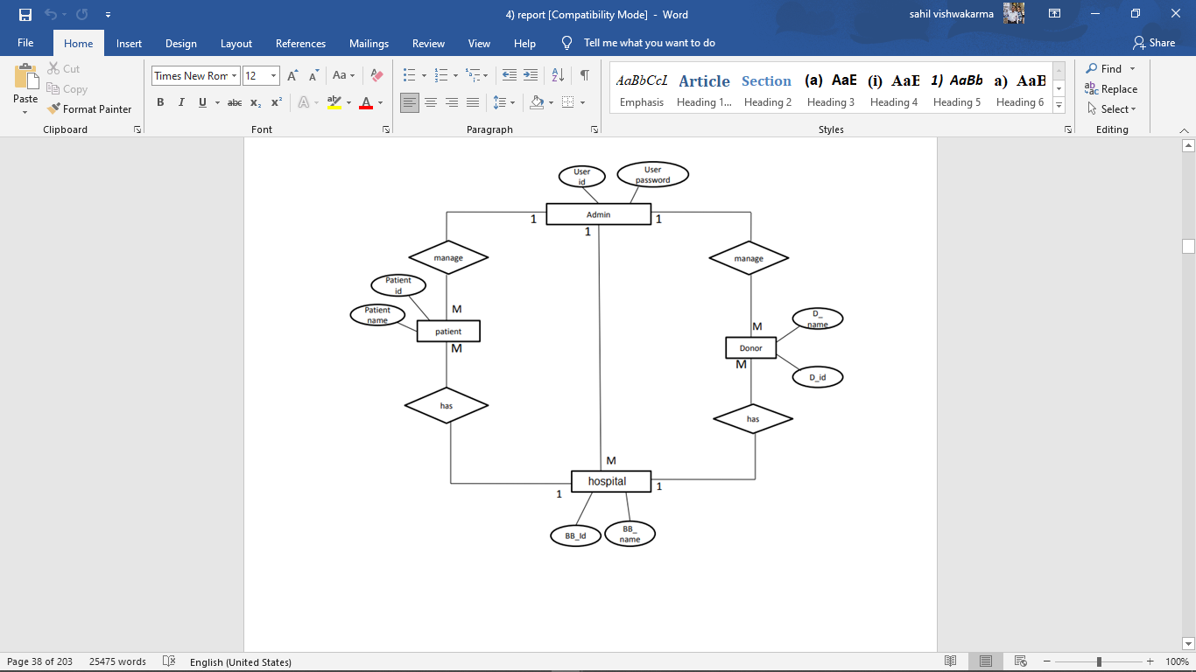

Slide 18
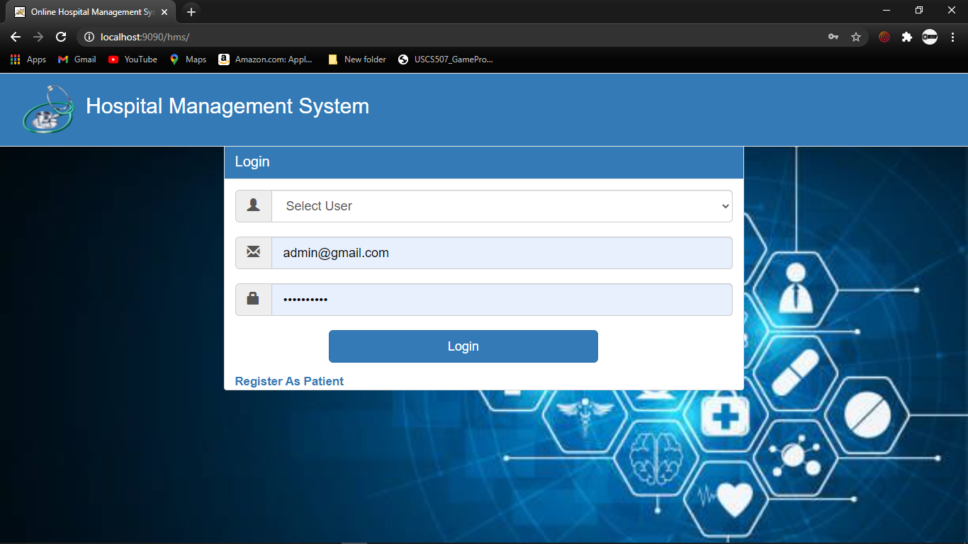
LOGIN PAGE

Slide 19
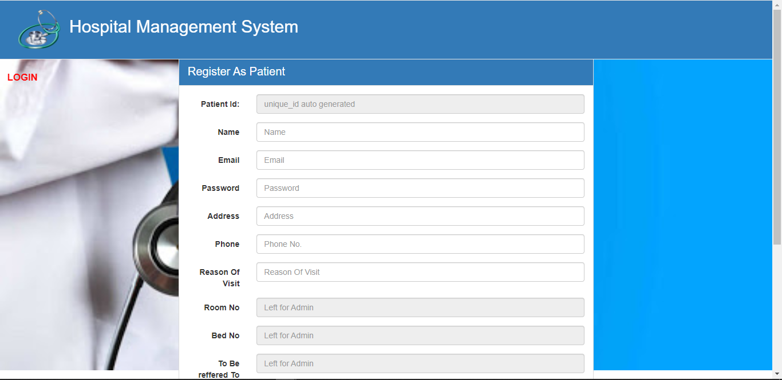
REGISTER PAGE

Slide 20
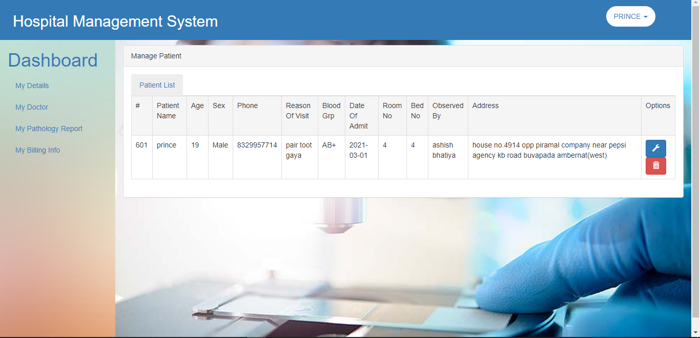
PATIENT HOME page PAGE

Slide 21
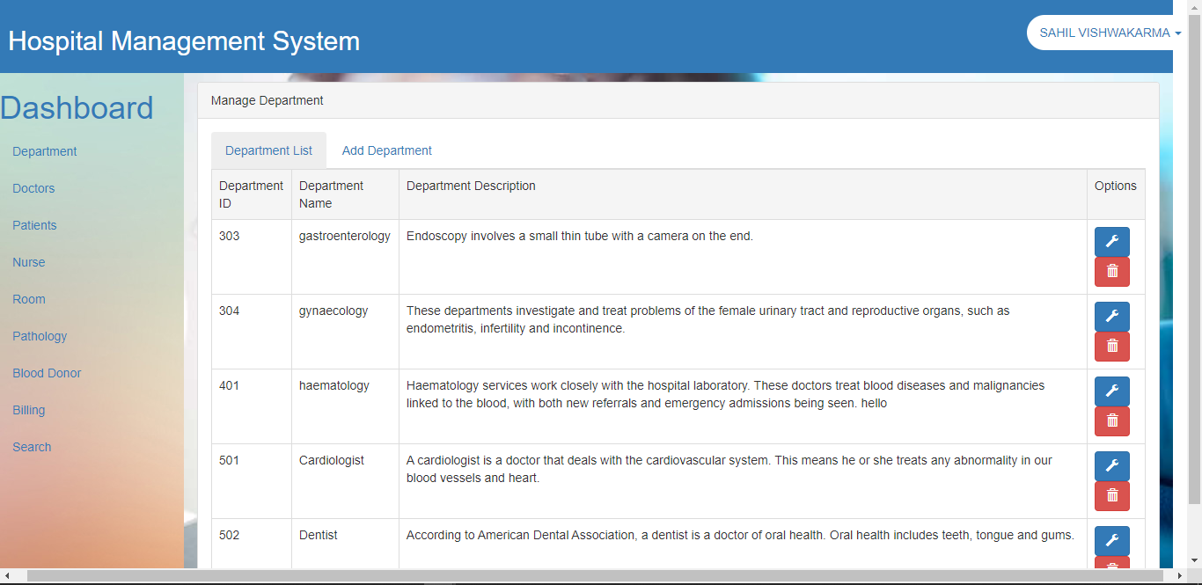
ADMIN HOME PAGE

Slide 22
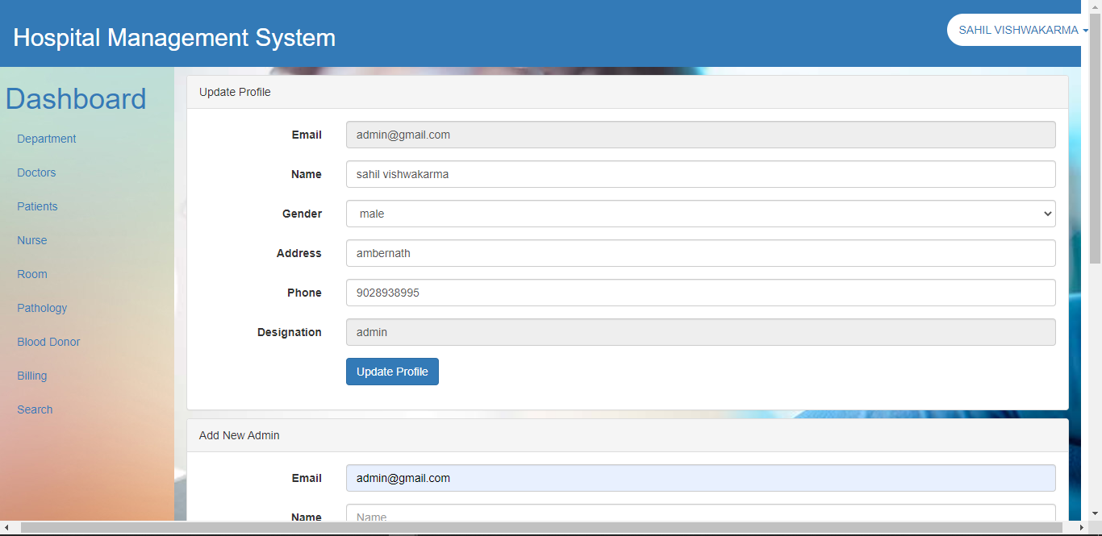
UPDATE PROFILE (ADMIN)

Slide 23
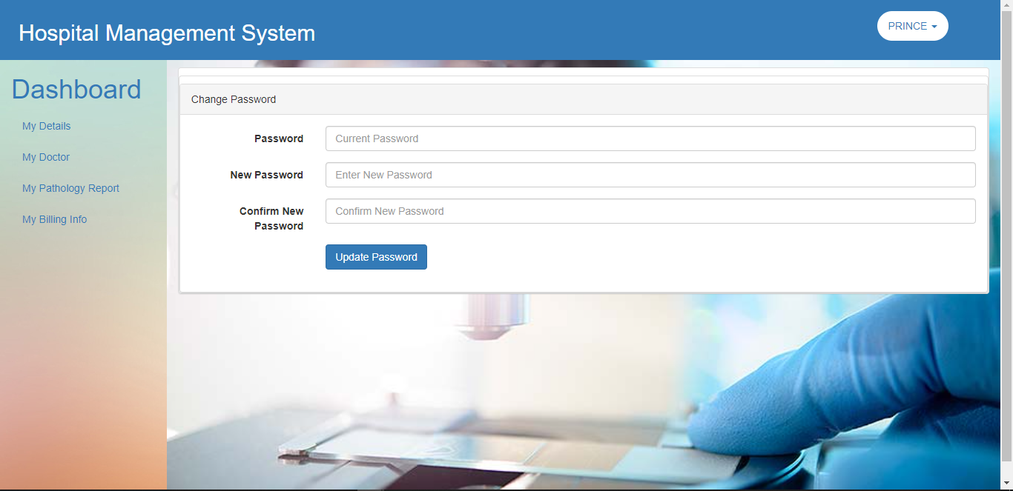
UPDATE PROFILE (PATIENT)

Slide 24
FURURE SCOPE OF PROJECT
The project “HOSPITAL MANAGEMENT SYSTEM” is generalized software and can be easily used in any department. The change in software can be easily accommodated.
The improvement in turnover of company up to any extent will be supported by software. The software will be able to provide its best facilities in case company starts online transactions in future. In this project, all the activities of the organization are performed manually.
To overcome all kind of problems being faced by organization. My project “HOSPITAL MANAGEMENT SYSTEM” will provide efficient and cost effective solution and always have possibilities of enhancement up any legal extent to satisfy user requirement.

Slide 25
BIBLIOGRAPHY
SOFTWARE ENGINEERING: Roger. S. Pressman.
THE COMPLETE REFERENCE JAVA-2: Patrick Naughtion & Herbert Schildt.
PROF. JAVA SERVER PROGRAMMING J2EE1.3: Subrahamanyam Allamaraju, Cedric Buest-Wrox Pub.
JAVA SCRIPT: Evan Baros.
DEVELOPING JAVA SERVLETS: James Goodwill, Techmedia
INTRODUCTION TO RDBMS: Vipin C. Desai.

Slide 26
BIBLIOGRAPHY
WEBSITES REFERENCED
www. learnHospital Management System.com (Overview And Basic Functionality)
www. java.sun.com (Java, Jsp, Servlet And Its Related Informations)
www. Oracle.com (Basic Informations Of Oracle 9i And Pdfs)
www.cs.ucl.ac.uk (Project Planning And Scheduling)
www.engin.umd.umich.edu (Software Testing Strategies)
www.GeekInterview.com (Introductions And Differences )
www.roseindia.net (Java, Jsp, Servlet, Oracle Basic Informations)

Slide 27
THANK YOU

